Slide 1
FoodCorp Inc Targeting Store 2 for New Marketing Campaign
Prajakta Zaavde (20549904)

Slide 2
ABOUT FoodCorp inc.
FoodCorp is a medium-sized dynamic company with a presence in Nottingham, Birmingham, and London.
They have a customer base of 11,474 and a diverse range of products comprising 21,812 unique items.
Analysis reveals that 156 products have never been sold in any stores.
Considering the number of products present in each store, Store 0 is the largest (127,366 products by quantity), while Store 3 is the smallest (44,152 products).
This presentation aims to showcase the potential of the Store 2, London branch for a new marketing campaign.

Slide 3
Performance of Stores
Sales, Customers and Products Distribution
Store | Sales | Customers | Products
0- Nottingham | £1,739,458.95 | 7,126 | 18,769
2- London (14 Handyside St) | £1,667,247.27 | 4,587 | 18,363
1- Birmingham | £871,941.18 | 2,495 | 14,628
3- London (300 Oxford) | £49,495.21 | 1,211 | 6,522

Slide 4
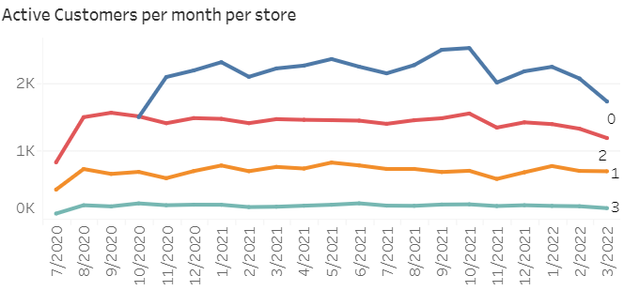
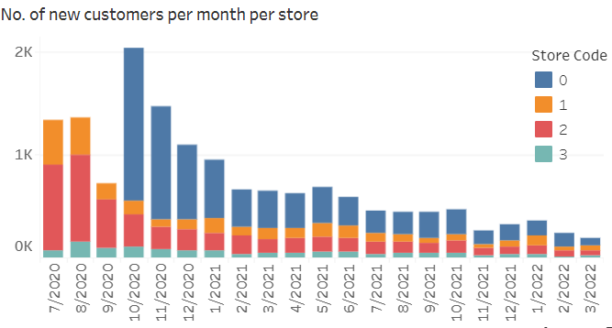
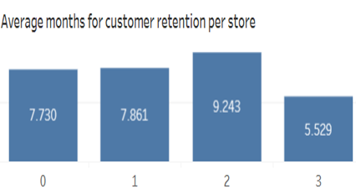
CUSTOMER METRICS
The overall average transaction value for each store:
Store 0 | Store 1 | Store 2 | Store 3
£244.100 | £349.475 | £363.472 | £40.871

Slide 5
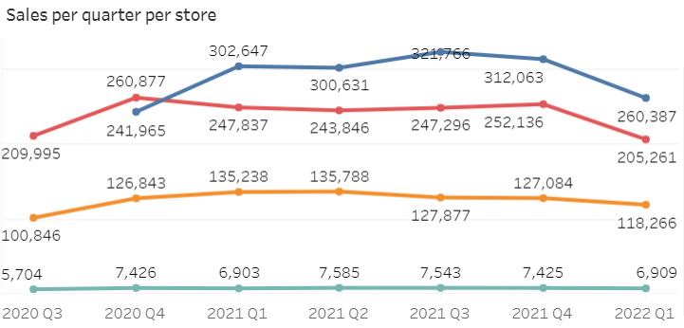

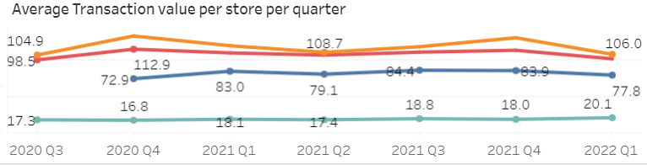
SALES METRICS
Q4 has performed well for all stores.
The month of October has brought the highest sales for all stores.
The average transaction value when calculated per quarter, is observed that Store 1 and Store 2 have values around £100.

Slide 6
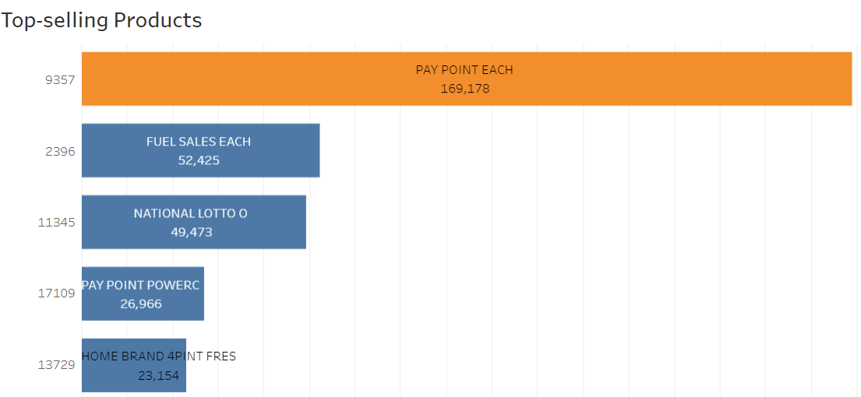
Product and department METRICS
The product code 9357 (Pay Point Each) emerges as a best-seller across all stores in terms of sales.
The best sellers by quantity vary, with ‘Bananas’ in the Fruits category leading in Store 0, Store 1, and Store 2, while Store 3 sees the highest quantity of milk sales.
Department Analysis:
 | Store 0 | Store 1 | Store 2 | Store 3
No. of departments | 42 | 39 | 42 | 33
Popular Department | Provisions Dairy | Cigarettes and Tobacco | Fruits and Vegetables | Fruits and Vegetables

Slide 7
Why Store 2 for marketing strategy?
Customers
Being the second largest store, it still has only 4,785 customers. Thus, a good opportunity for exploring new customers.
products
It has 18,363 distinct products available with 42 departments. Thus, huge variety to attract customers and improve sales.
Purchasing power
The average transaction value here is 363.472 for customers which is the highest. The no. of high-value customers is high as well with the count at 1119.
Customer retention
They have the highest customer retention period of 9.24 months.

Slide 8
Advantage for upselling products
Since the purchasing power of customers here is high, they can be encouraged better to try new products.
Fruits and vegetables being the most popular department show people’s inclination towards healthy foods.
This aligns seamlessly with the prevailing global emphasis on adopting a healthy lifestyle, thereby serving as a pivotal aspect for promoting new products with enhanced value within this category.

Slide 9
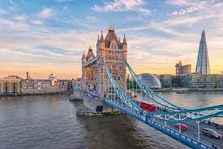
Conclusion
Considering all the strong factors mentioned below for Store 2:
Strong Performance
High Purchasing Power
Highest customer retention period
Huge unexplored customer base
It makes Store 2 have a greater scope for growth as compared to other stores, thus, making it the best choice for the marketing campaign.
BEST CHOICE

Slide 10
Thank you

